Slide 1
Reinforcement Learning
Ayorkor Korsah
Guest Talk in Machine Learning Class at Ashesi University
February 2019
Adapted from a lecture given by Ayorkor Korsah & Chika Yinka-Banjo at Data Science Africa 2018

Slide 2
Outline
Machine learning overview
Reinforcement learning definitions
Example reinforcement learning problems
The Markov decision process
The optimal policy
Value function & Q-value function
Bellman Equation
Q-learning
Building a simple Q-learning agent (coding)
Recap
Where to go from here?

Slide 3
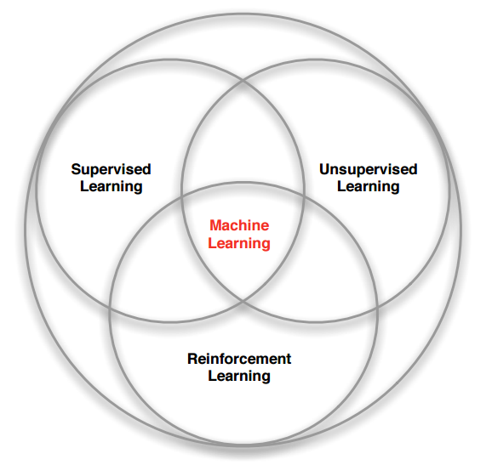
Machine Learning Overview
Machine learning techniques learn from data without being explicitly programmed to do so.
Machine learning models enable the agent to learn from its own experience by extracting useful information from feedback from its environment.
Three (sometimes 4) types of learning:
Supervised learning
Unsupervised learning
[Semi-supervised learning]
Reinforcement learning
Branches of Machine learning

Slide 4
Types of Machine Learning
Reference: https://towardsdatascience.com/machine-learning-types-2-c1291d4f04b1

Slide 5
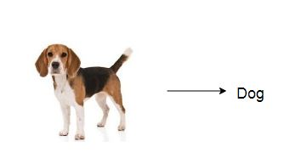
Supervised learning
Supervised learning: the machine learning model is trained on many labelled examples of input-output pairs.
Such that when presented with a novel input, the model can estimate accurately what the correct output should be.
Data(x, y): x is input data, y is label
Goal: learn a function to map x -> y
Examples include; Classification, regression object detection, image captioning etc.
Supervised learning task in the form of classification

Slide 6
Supervised Learning: Classification vs. Regression
Reference: https://towardsdatascience.com/coding-deep-learning-for-beginners-types-of-machine-learning-b9e651e1ed9d

Slide 7
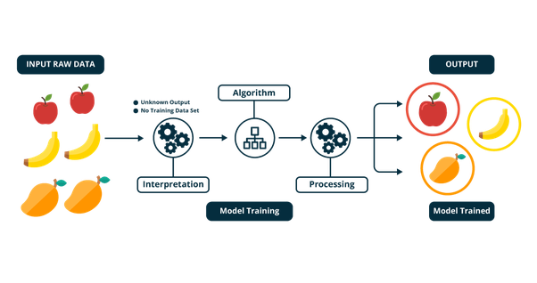
Unsupervised learning
Unsupervised learning: here the model extract useful information from unlabeled and unstructured data.
Data: x (raw data)
Goal: learn an underlining structure in the data that is not explicitly defined
Examples include; Clustering, density estimation, dimensionality reduction, etc.

Slide 8
Semi-supervised learning
Combination of supervised and unsupervised learning
The algorithm learns from a data set that includes some labelled data and a large amount of unlabelled data

Slide 9

Reinforcement learning
Reinforcement learning involves problems where an agent interacts with an environment that provides numeric reward signals
Goal: learn how to take actions in a given state, in order to maximize the reward.

Slide 10
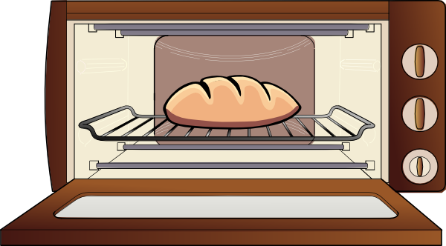
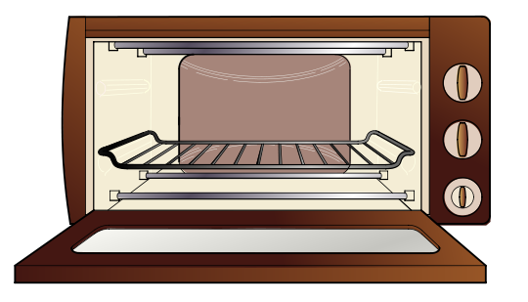


Reinforcement Learning
Learning by interacting with an environment
Trial-and-error learning: the agent takes actions and gets feedback through a numeral reward/penalty)
Action 1: try taking hot bread from oven without gloves
Action 2: take hot bread from oven with gloves
Reward: +100
Reward: -100

Slide 11
Supervised Learning versus Reinforcement Learning
Supervised Learning | Reinforcement Learning
Learns a function, f: X → Y that maps X (input) to Y (e.g. class label) | Learns a policy function π: S → A that maps from states to actions
We have labelled training data that indicates the correct Y for given X | We don’t have “labelled” training data that indicates the correct action to take for a given state
Agent learns directly from labelled data | Agent learns indirectly from time-delayed rewards collected through experience (trial-and-error)

Slide 12
Reinforcement learning definitions
Let’s define the key terms in reinforcement learning.
Agent: An agent takes actions; for example, a drone making a delivery, or Super Mario navigating a video game. The algorithm is run by the agent. In life, the agent is you.
Actions (A): A is the set of all possible moves the agent can make. An action is almost self-explanatory, but it should be noted that agents choose among a list of possible actions.
Environment: The world through which the agent moves. The environment takes the agent’s current state and action as input, and returns as output the agent’s reward and next state.
State (S): A state is a concrete and immediate situation in which the agent finds itself; i.e. a specific place and moment, an instantaneous configuration that puts the agent in relation to other significant things such as tools, obstacles, enemies or prizes.
Reward (R): A reward is the feedback by which we measure the success or failure of an agent’s actions.

Slide 13
Reinforcement learning definitions contd....
Discount factor: The discount factor is multiplied with future rewards as discovered by the agent in order to dampen their effect on the agent’s choice of action. It makes future rewards worth less than immediate rewards; i.e. it enforces a kind of greediness on the agent. Often expressed with the lower-case Greek letter gamma: γ.
Policy (π): The policy is the strategy that the agent employs to determine the next action based on the current state. It maps states to actions, the actions that promise the highest reward.
Value (V): The expected long-term return with discount, as opposed to the short-term reward R. Vπ(s) is defined as the expected long-term return of the current state under policy π. We discount rewards, or lower their estimated value, the further into the future they occur.
Q-value or action-value (Q): Q-value is similar to Value, except that it takes an extra parameter, the current action a. Qπ(s, a) refers to the long-term return of the current state s, taking action a under policy π. Q maps state-action pairs to rewards. Note the difference between Q and policy.
Trajectory: A sequence of states and actions that influence those states. From the Latin “to throw across.”

Slide 14
Toy Example
9 possible states: {S0, S1, …, S8}
5 possible actions in each state: {up, right, down, left, stay}
Rewards:
Attaining the goal state has a reward of +50
Trying to walk into a wall has a penalty (negative reward) of -5
All other actions have a reward of 0
By trial-and-error, the agent needs to learn an optimal policy, i.e. what the best action is to take in each state
S0
S1
S2
S3
S4
S5
S6
S7
S8

Slide 15
Toy Example – Examples of Effects of Actions
Results of actions from S2:
up: Reward = -5, Ends up still in S2
right: Reward = -5, Ends up still in S2
down: Reward = 0, Ends up in S5
left: Reward = 0, Ends up S1
stay: Reward = 0, Ends up still in S2
Results of actions from S6:
up: Reward = 0, Ends up still in S3
right: Reward = +50, Ends up in S7
down: Reward = -5, Ends up still in S6
left: Reward = -5, Ends up still in S6
stay: Reward = 0, Ends up still in S6
S0
S1
S2
S3
S4
S5
S6
S7
S8

Slide 16
Reinforcement Learning Examples
Pancake flipping robot (2010)

Slide 17
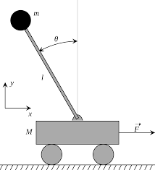
Reinforcement Learning Examples
Cart-pole problem
Objective: Balance a pole on top of a movable cart
State: angle, angular speed, position, horizontal velocity
Action: Horizontal force applied on cart
Reward: 1 at each time step if the pole is upright

Slide 18
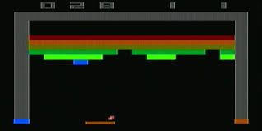
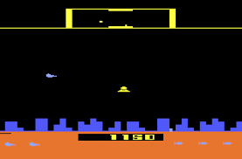
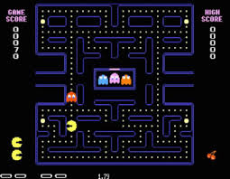
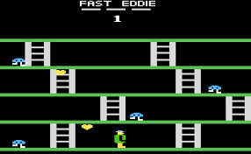
Reinforcement Learning Examples
Atari games
Objective: Complete the game with the highest score
State: Raw pixel inputs of the game state
Action: Game controls e.g. up, left, right , down.
Reward: Score increase or decrease at each time step

Slide 19
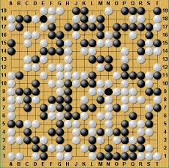
Reinforcement Learning Examples
Go (Board game)
Objective: Win the game!
State: Position of all the pieces
Action: Where to put the next piece down
Reward: 1 if win at the end of the game, 0 otherwise

Slide 20
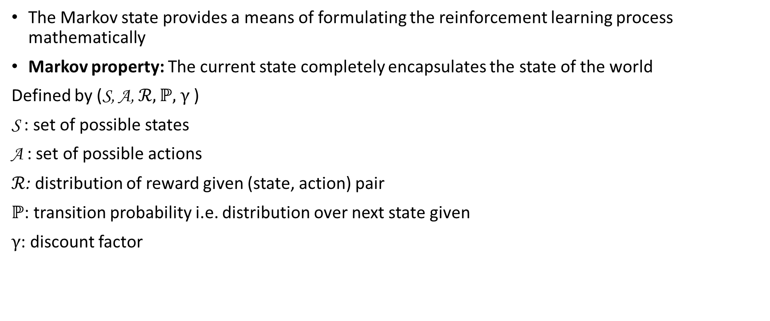
Markov Decision Process
The Markov state provides a means of formulating the reinforcement learning process mathematically
Markov property: The current state completely encapsulates the state of the world
Defined by (S, A, $ℛ, ℙ,$ $γ$)
S : set of possible states
A : set of possible actions
$ℛ$: distribution of reward given (state, action) pair
$ℙ$: transition probability i.e. distribution over next state given
$γ$: discount factor

Slide 21
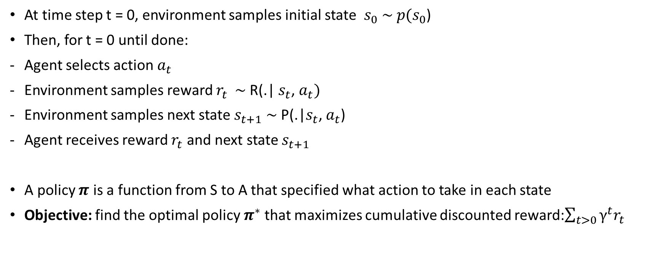
Markov Decision Process
At time step t = 0, environment samples initial state $s_{0}$ $\sim p(s_{0}$)
Then, for t = 0 until done:
Agent selects action $a_{t}$
Environment samples reward $r_{t}$ $\sim$R(.| $s_{t}$, $a_{t})$
Environment samples next state $s_{t+1}$ $\sim$ P(.|$s_{t}$, $a_{t}$)
Agent receives reward $r_{t}$ and next state $s_{t+1}$
A policy $π$ is a function from S to A that specified what action to take in each state
Objective: find the optimal policy $π^{∗}$ that maximizes cumulative discounted reward:$\sum_{t>0}{γ^{t}r_{t}}$

Slide 22
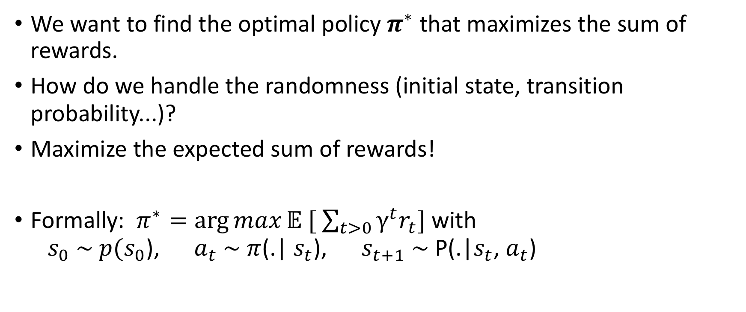
The optimal policy
We want to find the optimal policy $π^{∗}$ that maximizes the sum of rewards.
How do we handle the randomness (initial state, transition probability...)?
Maximize the expected sum of rewards!
Formally: $π^{∗}=\arg{max}𝔼 [ \sum_{t>0}{γ^{t}r_{t}}]$ with $s_{0}$ $\sim p(s_{0}$), $a_{t}$ $\sim$ $π$(.| $s_{t}$), $s_{t+1}$ $\sim$ P(.|$s_{t}$, $a_{t}$)

Slide 23
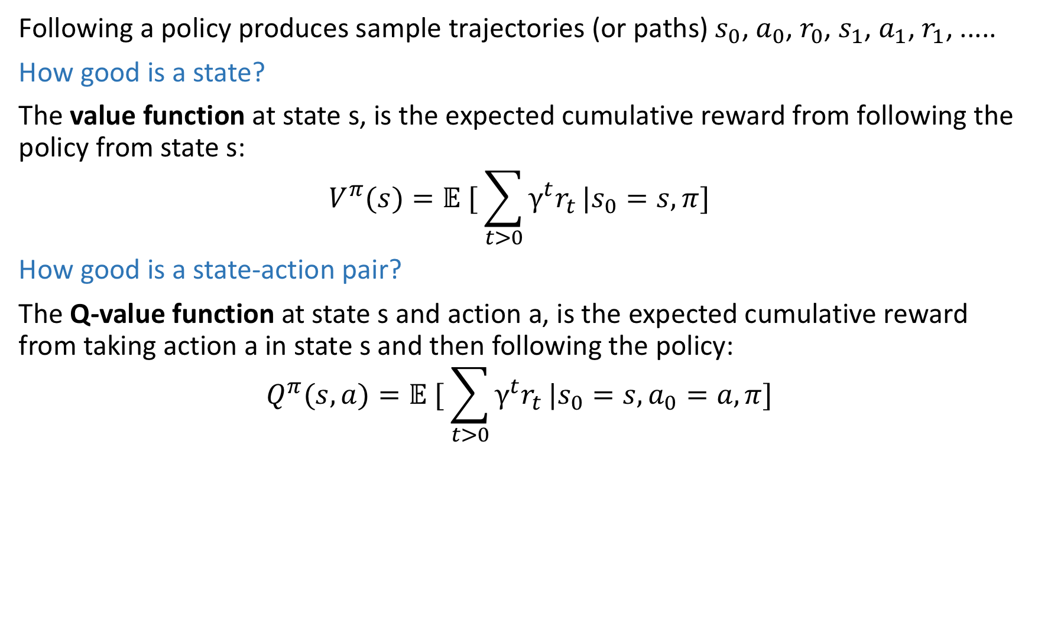
Value function and Q-value function
Following a policy produces sample trajectories (or paths) $s_{0}$, $a_{0}$, $r_{0}$, $s_{1}$, $a_{1}$, $r_{1}$, .....
How good is a state?
The value function at state s, is the expected cumulative reward from following the policy from state s:
$$V^{π}(s)=𝔼 [ \sum_{t>0}{γ^{t}r_{t}}|s_{0}=s,π]$$
How good is a state-action pair?
The Q-value function at state s and action a, is the expected cumulative reward from taking action a in state s and then following the policy:
$$Q^{π}(s,a)=𝔼 [ \sum_{t>0}{γ^{t}r_{t}}|s_{0}=s,a_{0}=a, π]$$

Slide 24
Q-Table
A table of Q-values for each state-action pair
Q-value estimates the expected long-term reward for taking a given action from a given state
 | Action 1 | Action 2 | Action 3
State 1 | Q(s1,a1) | Q(s1,a2) | Q(s1,a3)
State 2 | Q(s2,a1) | Q(s2,a2) | Q(s2,a3)
State 3 | Q(s3,a1) | Q(s3,a2) | Q(s3,a3)
State 4 | Q(s4,a1) | Q(s4,a2) | Q(s4,a3)
State 5 | Q(s5,a1) | Q(s5,a2) | Q(s5,a3)
State 6 | Q(s6,a1) | Q(s6,a2) | Q(s6,a3)
State 7 | Q(s7,a1) | Q(s7,a2) | Q(s7,a3)

Slide 25
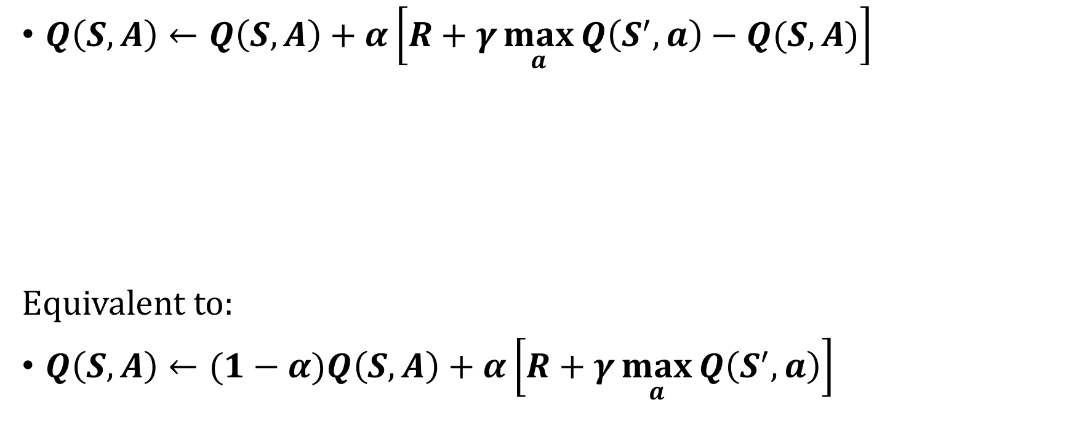
Bellman Equation for updating the Q-values
R – Reward from taking action A in state S
$Q\left(S,A\right)←Q\left(S,A\right)+α\left[R+γ\max_{a}{Q\left(S^{′},a\right)−Q(S,A)}\right]$
Equivalent to:
$Q\left(S,A\right)←(1−α)Q\left(S,A\right)+α\left[R+γ\max_{a}{Q\left(S^{′},a\right)}\right]$
S’ – New state resulting from taking action A in state S
A – Chosen action
S – Current state
$γ$ = Discount factor – how important are future rewards? $(0≤γ≤1)$
$α$= Learning rate – how much do we update the q-value in each iteration? $(0<α≤1)$

Slide 26
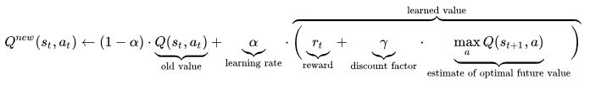
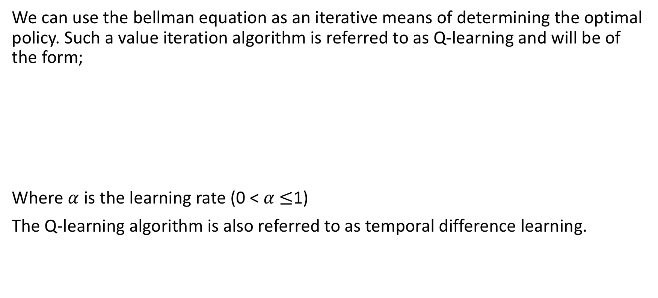
Q-learning
We can use the bellman equation as an iterative means of determining the optimal policy. Such a value iteration algorithm is referred to as Q-learning and will be of the form;
Where $α$ is the learning rate (0 < $α$ $≤$1)
The Q-learning algorithm is also referred to as temporal difference learning.

Slide 27
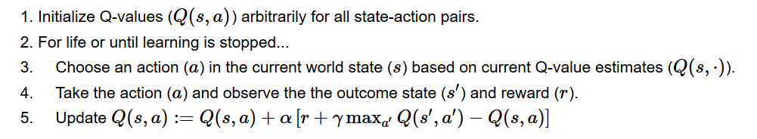
Q-learning - Algorithm

Slide 28
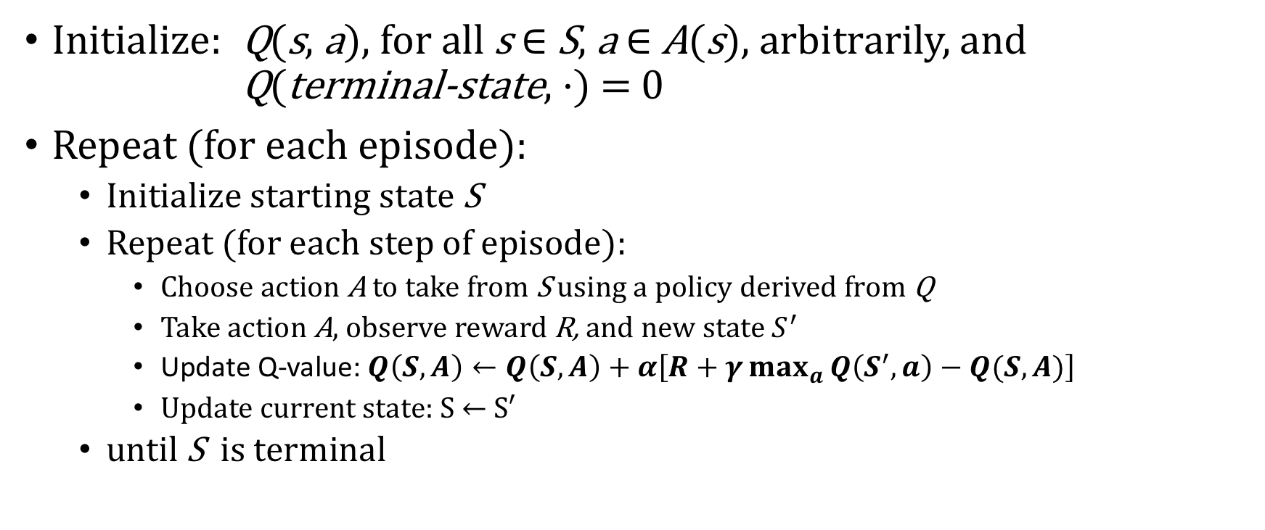
Q-Learning Algorithm
Initialize: Q(s, a), for all s ∈ S, a ∈ A(s), arbitrarily, and Q(terminal-state, ·) = 0
Repeat (for each episode):
Initialize starting state S
Repeat (for each step of episode):
Choose action A to take from S using a policy derived from Q
Take action A, observe reward R, and new state $S^{′}$
Update Q-value: $Q\left(S,A\right)←Q\left(S,A\right)+α\left[R+γ\max_{a}{Q\left(S^{′},a\right)−Q(S,A)}\right]$
Update current state: S ← S′
until S is terminal
Sometimes the agent explores - tries random actions
Sometimes the agent exploits – chooses the best action based on its prior experience

Slide 29
Building a simple Q-learning agent

Slide 30
Recap
Reinforcement learning as a branch of machine learning, involves an agent-environment relationship where the agent chooses actions that maximize a reward within that environment
A policy is the strategy the agent employs to determine the next action given its current state. The goal is to optimize the policy that returns the maximum cumulative future reward.
The Q-value function is a key function for estimate the maximum expected reward given a state-action pair
The Q-value function optimizes and updates the agents policy
The Q-learning algorithm is an iterative algorithm for estimating the Q-value for state-action pairs.

Slide 31
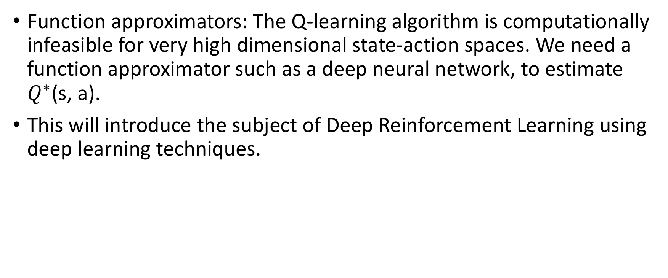
Where to go from here?
Function approximators: The Q-learning algorithm is computationally infeasible for very high dimensional state-action spaces. We need a function approximator such as a deep neural network, to estimate $Q^{∗}$(s, a).
This will introduce the subject of Deep Reinforcement Learning using deep learning techniques.

Slide 32
Further Reading
Reinforcement Learning: An introduction by Sutton and Barto
Deep Reinforcement Learning: An overview by Yuxi Li
Jens Kober, J. Andrew Bagnell and Jan Peters, “Reinforcement learning in robotics: A survey”, International Journal of Robotics Research, 32(11) 1238–1274
Florentin Woergoetter and Bernd Porr (2008), Scholarpedia, 3(3):1448 http://www.scholarpedia.org/article/Reinforcement_learning
Satwik Kansal and Brendan Martin, “Reinforcement Q-Learning from Scratch in Python with OpenAI Gym”, https://www.learndatasci.com/tutorials/reinforcement-q-learning-scratch-python-openai-gym/

Slide 33
Examples
https://www.youtube.com/watch?v=vppFvq2quQ0&feature=youtu.be

Slide 34
Thank you

